Slide 1
PROJECT-1 POLY-ALPHABETIC CIPHER
Chetan(2020046), Pratham Koli(2020453)

Slide 2
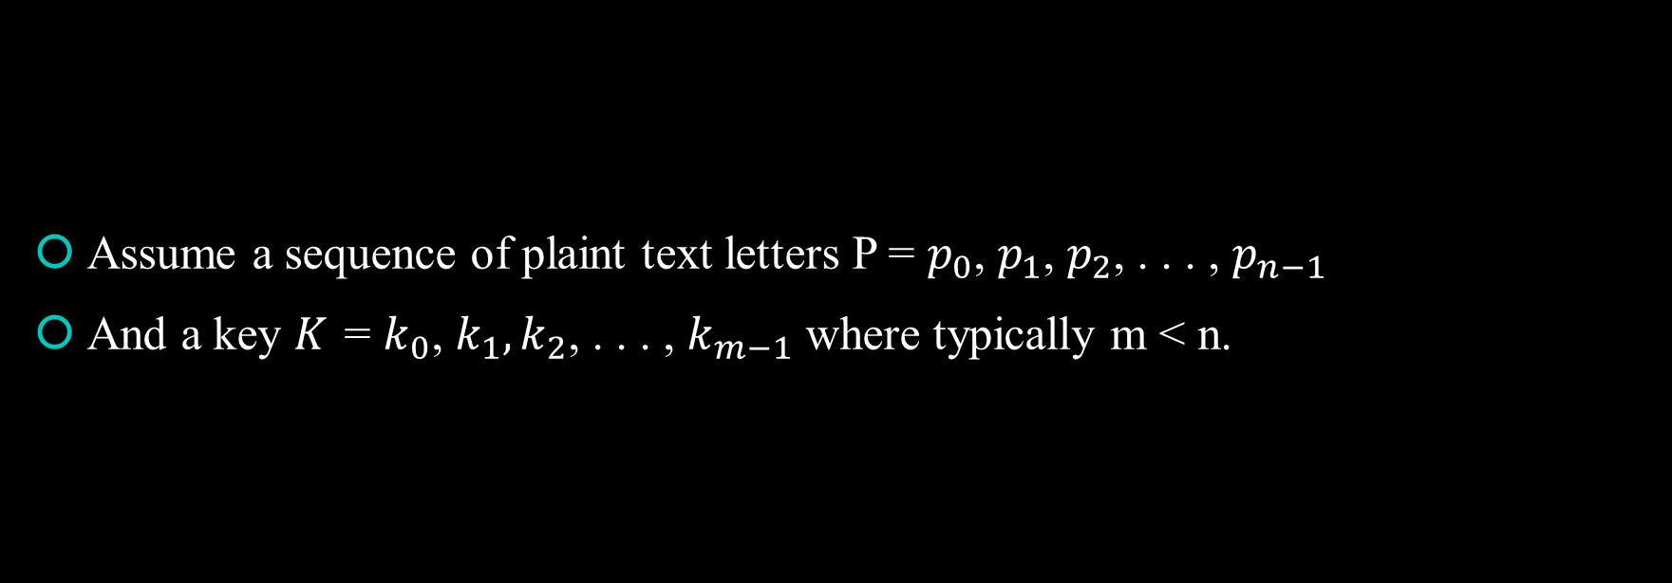
Poly-Alphabetic Cipher
Assume a sequence of plaint text letters P = $p_{0}$, $p_{1}$, $p_{2}$, . . . , $p_{n−1}$
And a key $K_{ }$ = $k_{0}$, $k_{1},k_{2}$, . . . , $k_{m−1}$ where typically m < n.

Slide 3
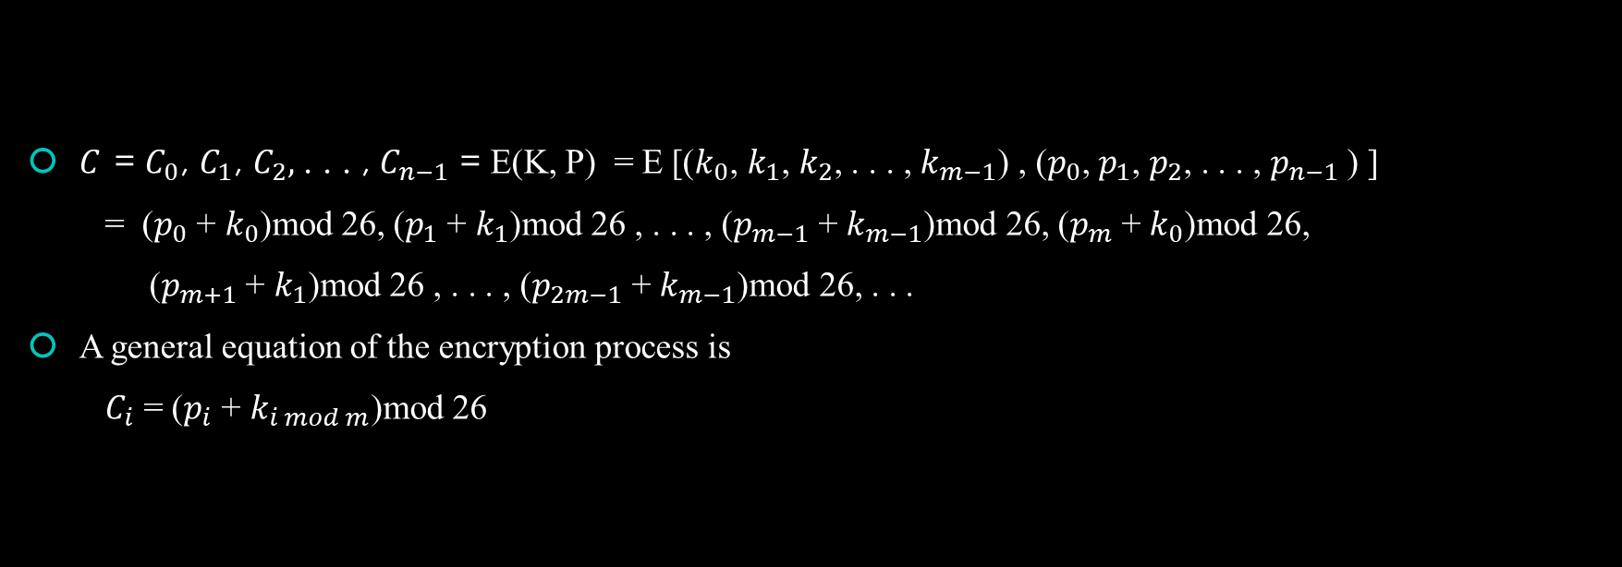
Ciphertext Calculation
$C_{ }$ = $C_{0}$, $C_{1}$, $C_{2},$. . . , $C_{n−1}$ = E(K, P) = E [($k_{0}$, $k_{1}$, $k_{2}$, . . . , $k_{m−1}$) , ($p_{0}$, $p_{1}$, $p_{2}$, . . . , $p_{n−1}$) ]
= ($p_{0}$ + $k_{0}$)mod 26, ($p_{1}$ + $k_{1}$)mod 26 , . . . , ($p_{m−1}$ + $k_{m−1}$)mod 26, ($p_{m}$ + $k_{0}$)mod 26,
($p_{m+1}$ + $k_{1}$)mod 26 , . . . , ($p_{2m−1}$ + $k_{m−1}$)mod 26, . . .
A general equation of the encryption process is
$C_{i}$ = ($p_{i}$ + $k_{i mod m}$)mod 26

Slide 4
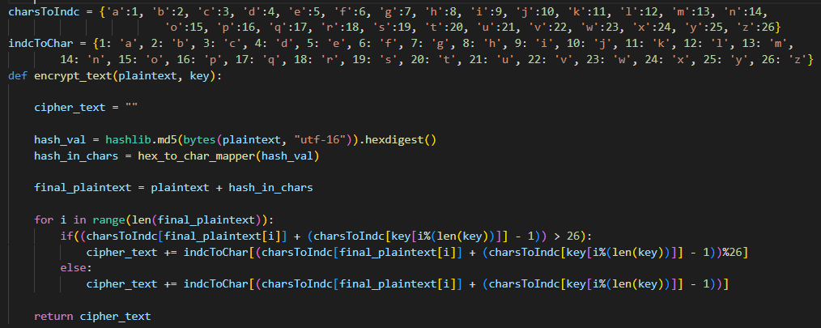
Encryption Algorithm

Slide 5
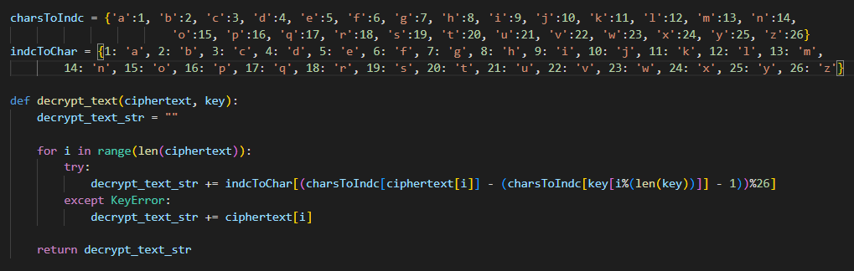
Decryption Algorithm

Slide 6
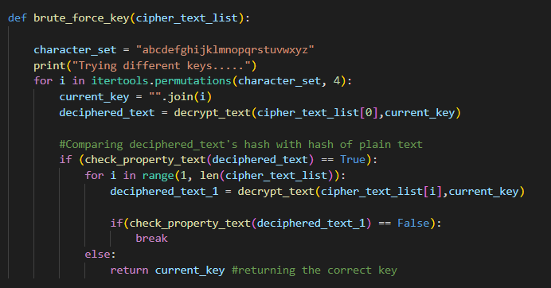
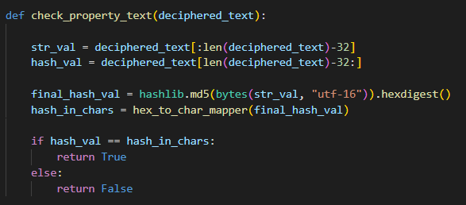
Brute Force Attack

